Slide 1
Breeding Resistance to
Chestnut Blight
Canadian Chestnut Council

Slide 2
Background
Disease testing
Second Generation
Nuts Size
Grants and 2013 Activities

Slide 3
Background
Disease testing
Second Generation
Nut Size
Grants and 2013 Activities

Slide 4
Revisions To Plan - 2006
Goal: to breed blight resistant American chestnuts adapted to Ontario within 20 years (from 2000).
Objectives:
To develop blight resistant trees of 100% Canadian origin
To develop blight resistant trees incorporating genes from Connecticut trees such that the trees are at least 92% of Canadian origin
Maintain present genetic diversity of existing Canadian trees

Slide 5
Phase 1
1. Resistant trees will contain the known resistant genes from the Chinese or Japanese trees
2. At least 20 Canadian trees will be used in the F1 crosses.
3. Canadian parental trees will be used as the female parent in the first generation.

Slide 6
Phase 1 (cont.)
First generation hybrid crosses will be between:
↳ Canadian native chestnut trees and blight resistant trees from another source.
↳ Crosses between native chestnut trees (The Endangered Species Act)

Slide 7
Phase 2
Second generation trees will come from intercrossing selected F1 trees.
Parents in each cross derived from different Canadian trees.

Slide 8
Phase 3
Third generation trees will come from intercrossing selected F2 trees.
Parents in each cross derived from different Canadian trees.

Slide 9
The mother trees
43 trees selected throughout Ontario
- Ontario chestnut survey (Boland and Husband 2000)
26 trees pollinated
Problems encountered
  Trees inaccessible
  Trees too tall

Slide 10
Map of mother trees
Selected Mother Trees
Pollinated Mother Trees

Slide 11
The father trees - Connecticut
Sandy's Tree
back crossed twice
American x {Chinese x [(Japanese x European) x American]}
2. Two Trees R2T10 and R2T8
back crossed three times
American x {American x [(Japanese x Chinese) x American]}

Slide 12
First Generation
767 Back-cross trees with Connecticut pollen
  - Sandy’s tree (BC3)
  - R2T8 (BC4)
  R2T10 (BC4)
643 Canadian trees

Slide 13
Background
Disease testing
Second Generation
Nut Size
Grants and 2013 Activities

Slide 14
Mechanisms of Disease Resistance
Prevent fungus entering through bark
Produce chemicals to kill/slow down fungus
    - phytoalexins
Surround fungus with a barrier
    - callus

Slide 15
Methods to estimate disease resistance
Longevity
Spore inoculations
Mycelial inoculations
    Branches in F1 generation
    Trunks in F2 generation

Slide 16
Branch Inoculations
Low levels of resistance in Canadian trees
Prevent trees dying
    breeding genepool
2 isolates
2 years
Measure lesions at least twice
Rate of expansion measured
    No correlation of resistance with initial lesion growth (Fred Hebard, TACF)

Slide 17
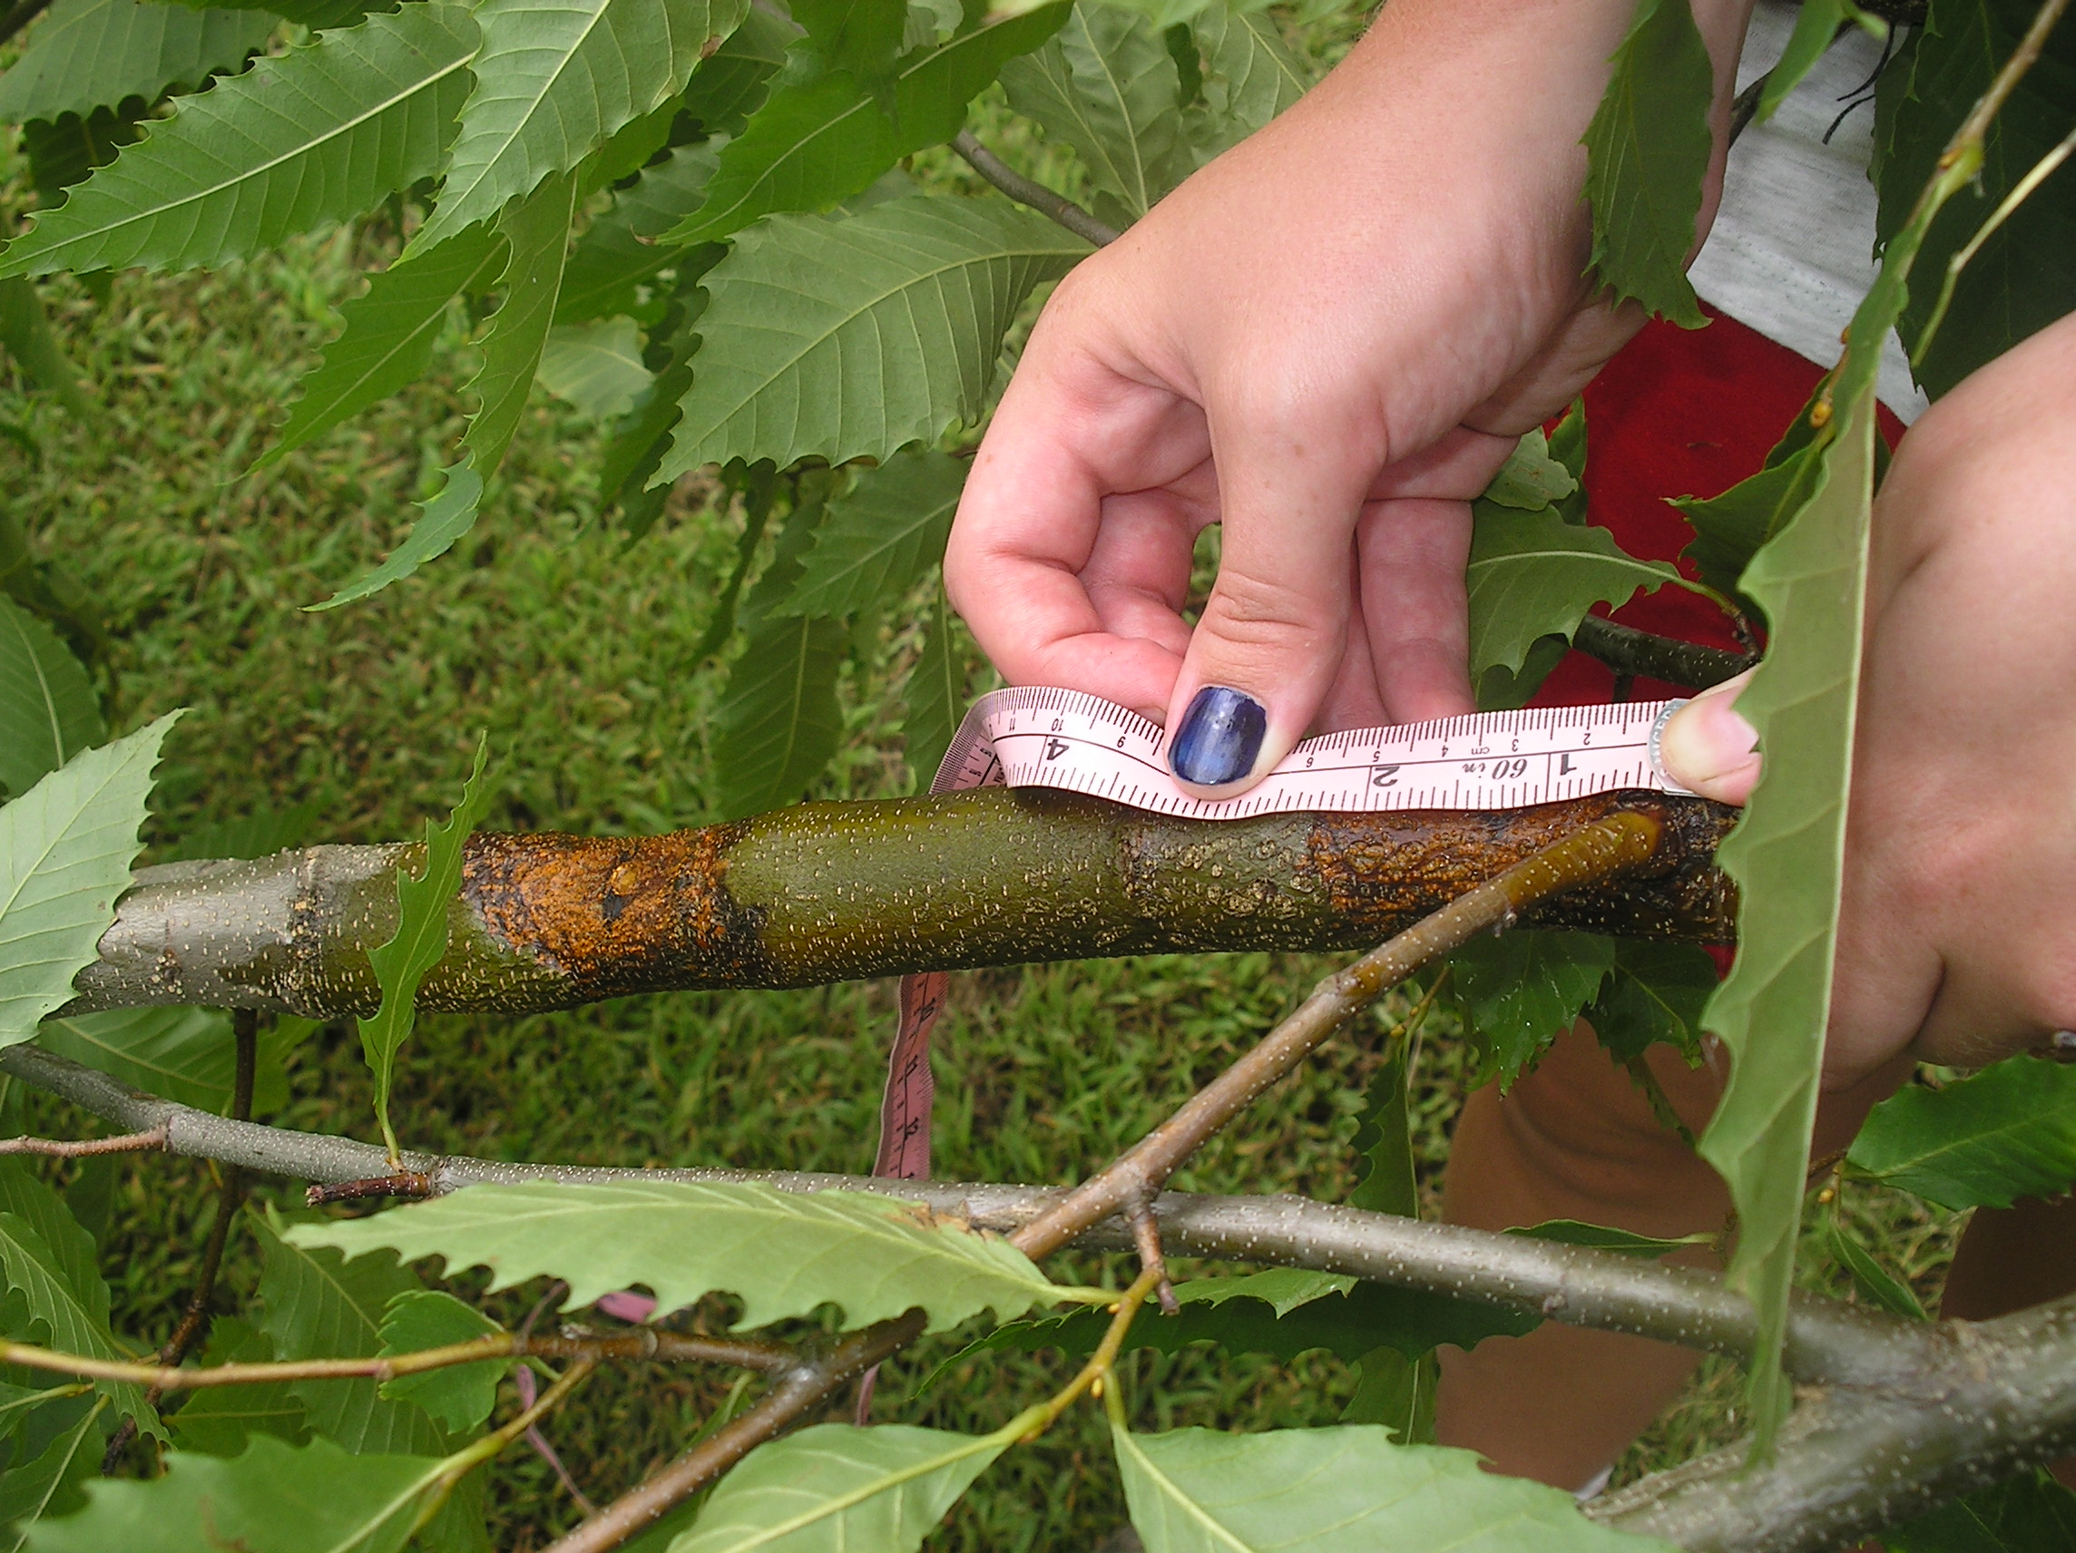

Slide 18
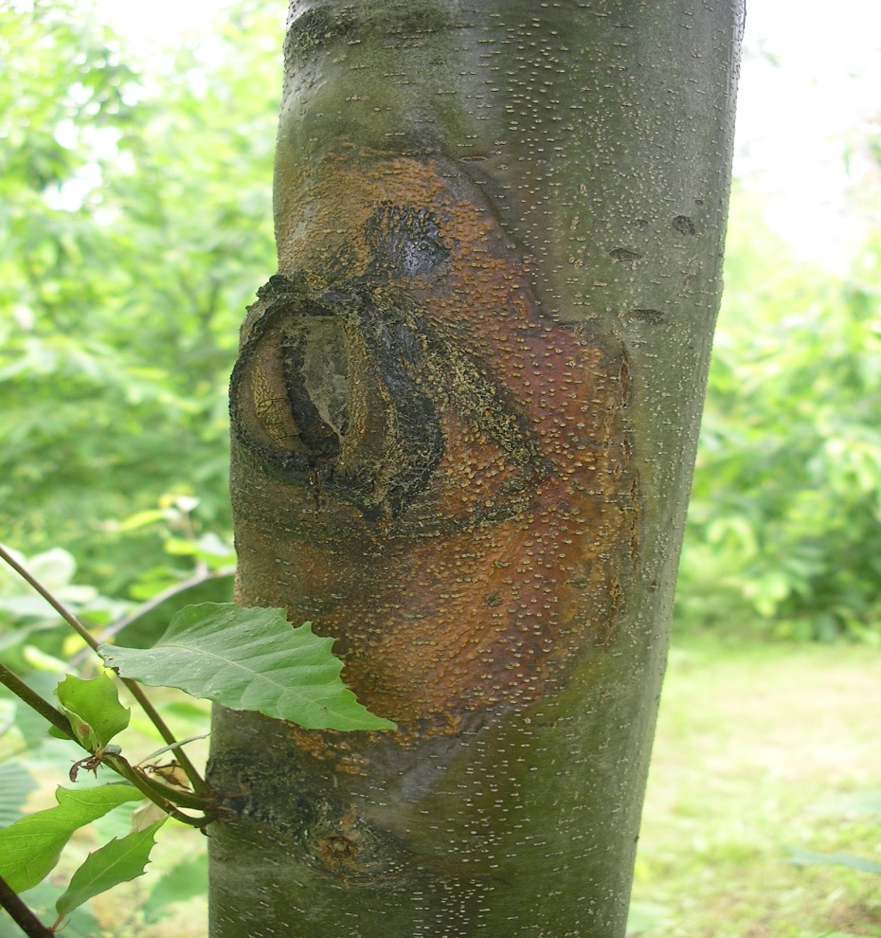
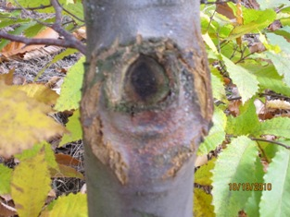

Slide 19
Mean Daily Increase in Lesion Area
2012

Slide 21
Canadian Trees Selected Before 2012
Riverbend Farms
  R2T4, R2T5, R6T25 Light Cemetery x Canadian
  R6T58 Balough o.p.
  R7T75 Riverbend Farm o.p.
  R2T21, R2T22, R2T23, R4T10 –
  Marshall x Canadian
  R7T77 Minnesota o.p.

Slide 22
Canadian Trees Selected Before 2012
Onondaga Farm
  R1T9, R1T18 Gundry x Canadian
  R2T4 Bradshaw o.p.
  R2T15, R3T8 Light Cemetery x
  Canadian
  R4T31 Marshall x Canadian
  R12T18, R12T23 Marshall x Dundas

Slide 23
Back-cross Trees Selected Before 2012
Riverbend
  R3T7 Riverbend x R2T8
  R3T14 Riverbend x Sandy
  R4T1 Light Cemetery x R2T8
  R5T10 Chestnut Ridge x R2T10
  R5T32 Glen Meyer x R2T8
  R5T34 Chestnut Ridge x Sandy

Slide 24
Back-cross Trees Selected Before 2012
Riverbend (cont.)
  R5T49 Lathrop OP
  R6T60 Persall x R2T10
  R7T1 Glen Meyer x R2T10
  R7T36 Hodgson 12 x Sandy

Slide 25
Back-cross Trees Selected before 2012
Onondaga
  R3T8 Light Cemetery x R2T8
  R3T22 Marshall x R2T8
  R5T20 Marshall x Sandy
  R5T28 BR5 x Sandy
  R5T29 Burford x R2T10
  R6T7 Persall x Sandy
  R6T16 Island Lake x Sandy
  R6T33 Gundry x R2T8
  R7T37 Marshall x Sandy

Slide 26
Canadian Trees Selected in 2012
Onondaga
  R11T4N –Hodi o.p.
  Riverbend Farm
  R6T58 Balough o.p.
  R8T16, R9T9, R9T10 Marshall x Dundas

Slide 27
Back-cross Trees Selected in 2012
Onondaga
  R11T6N Dundas x R2T8
  R13T6N Kerr o.p.
  R15T7N GRCA x R2T8
  R16T8N Kerr o.p.
  R16T17N Marshal x R2T10

Slide 28
Back-cross Trees Selected in 2012
Riverbend Farm
  R6T55 Marshall x R2T8
  R6T67 Glen Meyer x R2T8
  R8T75 Dundas x R2T8

Slide 29
Progress to end of 2013 (cont.)
Established F2 parents nursery
↳ 54 trees
-10 different parents
Developed two propagation techniques
↳ cuttings propagation
↳ etiolated sprout grafting

Slide 30
Background
Disease testing
Second Generation
Nut Size
Grants and 2013 Activities

Slide 31
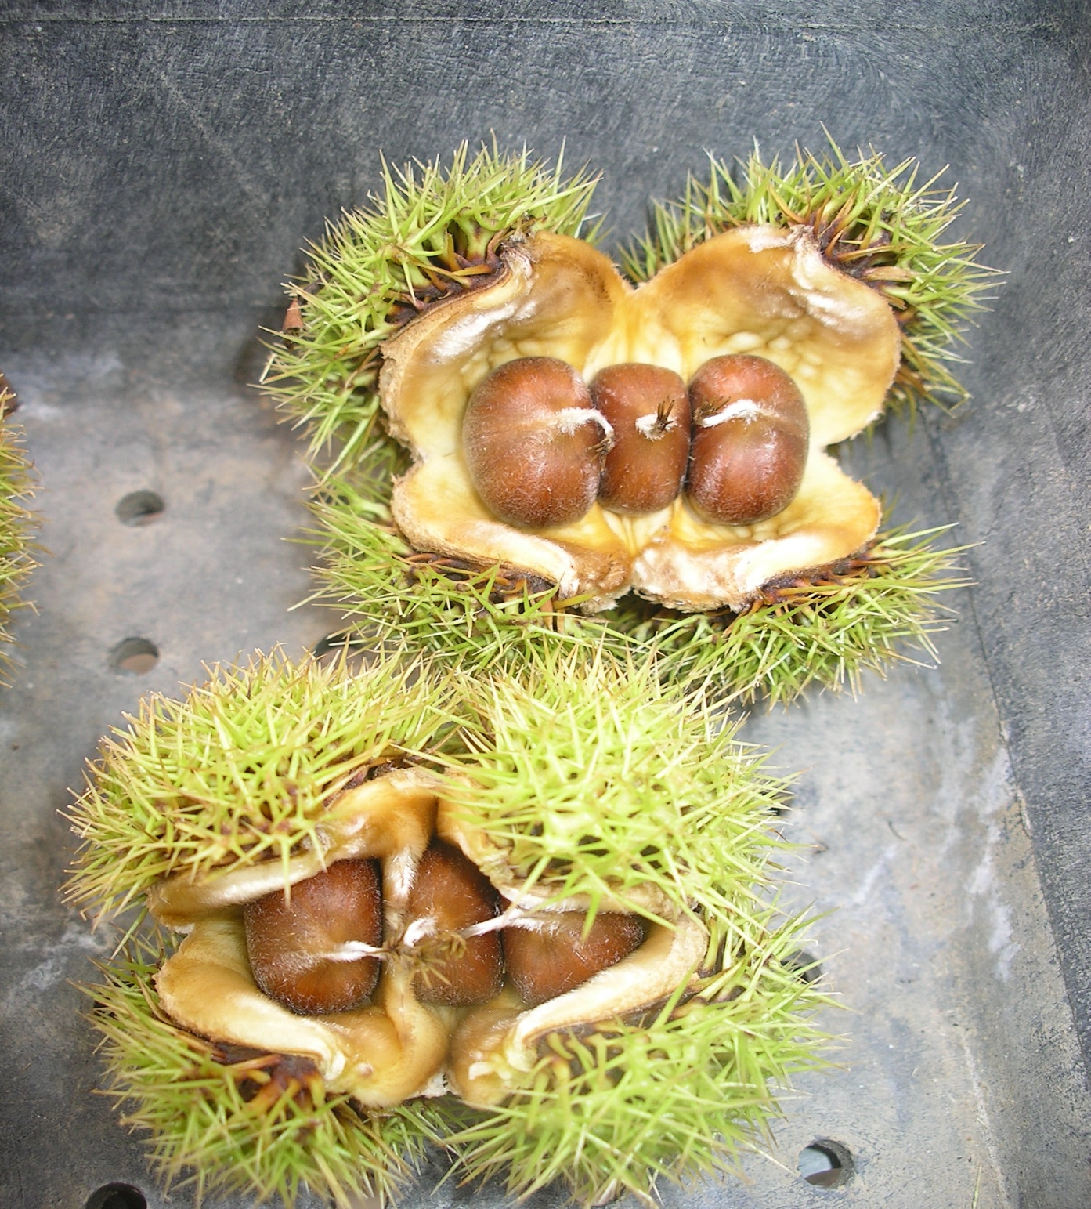

Slide 32
Progress to end of 2013 (cont.)
Pollination 2013
↳ pollinated 21 trees
↳ made 46 crosses
↳ collected 2006 nuts of crosses
↳ 500+ o.p. nuts from selected trees

Slide 33
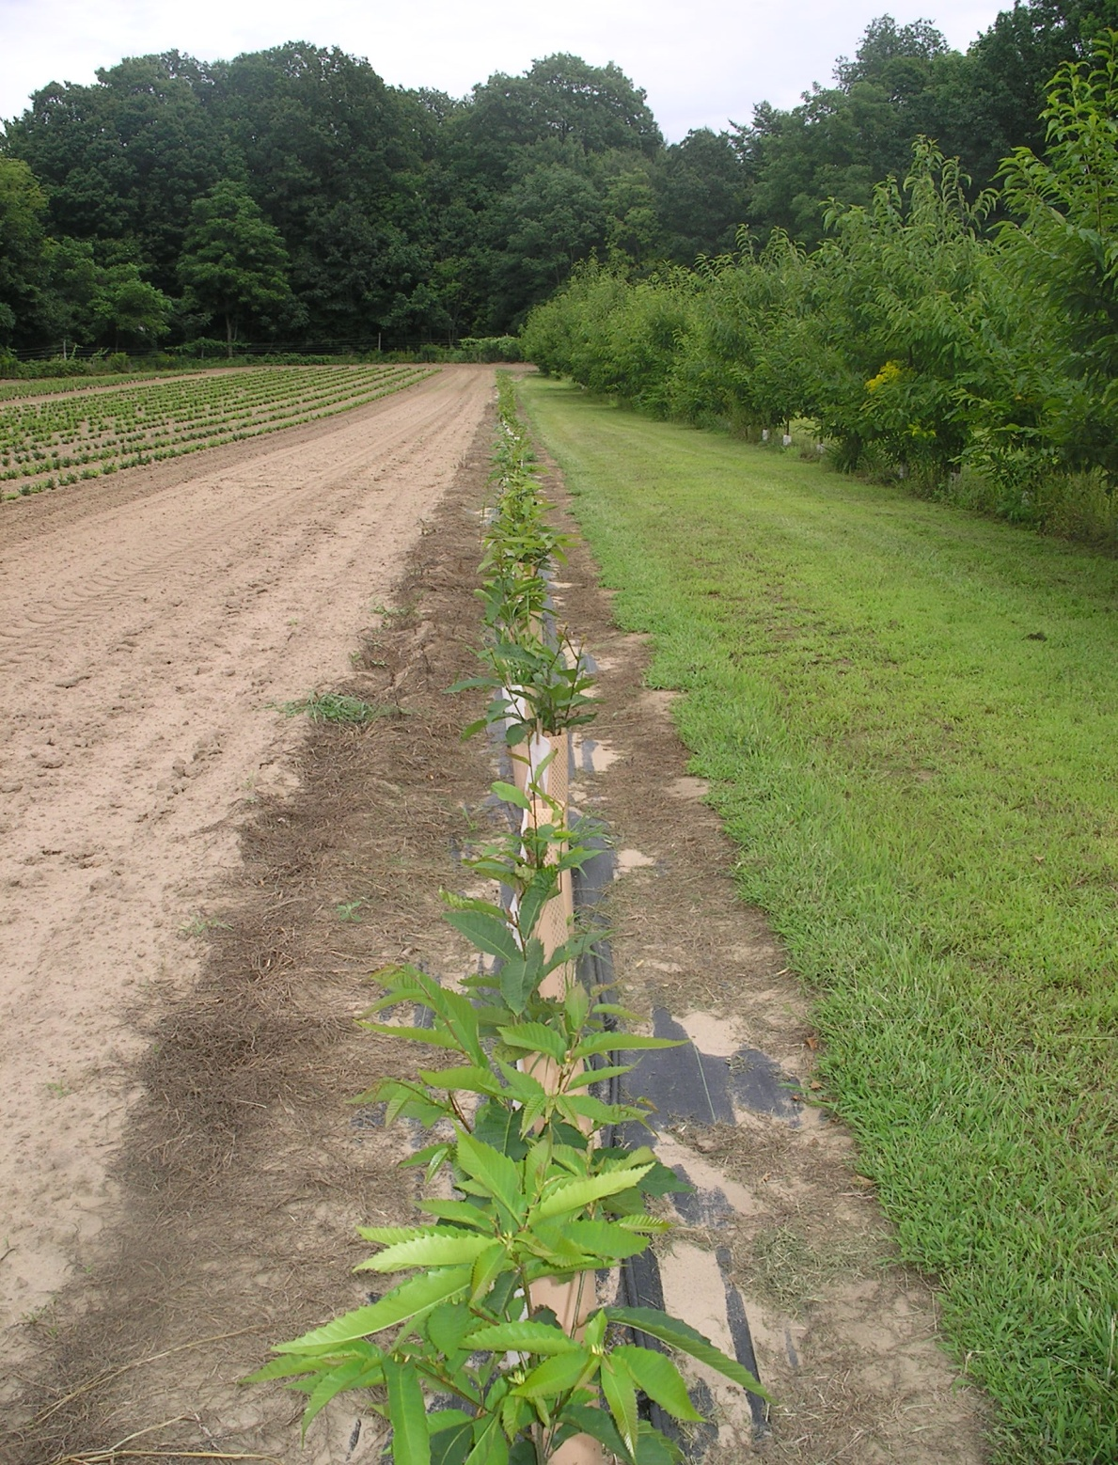

Slide 34
2nd Generation
Year | Trees Planted | Nuts Collected | Location
2010 |  | 474 | RBF/Onondaga
2011 | 334 | 2461 | Casier/Onondaga
2012 | 1576 | 557 | Casier
2013 | 195 | 2006 | Casier/Onondaga

Slide 35
Background
Disease testing
Second Generation
Nuts Size
Grants and 2013 Activities

Slide 36
Nut Size

Slide 37
Nuts Size vs Number of Nuts per Burr at Onondaga

Slide 38
Nut Size

Slide 39
Nut Size vs Number of Nuts per Burr at Riverbend

Slide 40
Background
Disease testing
Second Generation
Grants and 2014 Activities

Slide 41
Grants received
Ontario Ministry of Natural Resources
  Species at Risk fund
  $30,752 per year for May 2012- Apr 2015
  CCC
    in-kind contribution
    Volunteers time
  Activities
    Breeding
    Research into cuttings

Slide 42
2014 Activities
Select trees from 2012/13 inoculations
Remove infected trees
Maintain trees as genepool for further breeding
Make F2 crosses with identified trees
Initiate trunk inoculations on 2nd generation
Continue cuttings/grafting research
Develop plan for distribution of nuts from resistant trees

Slide 43
Sponsors in alphabetical order
Agricultural Adaptation Council – CAAP fund
Species at Risk Stewardship Fund – Government of Ontario
Tim Hortons Foundation
Riverbend Farms
The Trillium Foundation
Elgin and Norfolk Stewardship Councils
University of Guelph
All members (past and present) of the Canadian Chestnut Council

